Slide 1
Computer Systems:
A Programmer’s Perspective
程序设计与计算机系统
Lecture 13b
Thread Programming
January 11, 2016
Wu junmin (jmwu@ustc.edu.cn)

Slide 2
Review: Semaphores
Semaphore: non-negative global integer synchronization variable. Manipulated by P and V operations.
P(s)
  If s is nonzero, then decrement s by 1 and return immediately.
  If s is zero, then suspend thread until s becomes nonzero and the thread is restarted by a V operation.
  After restarting, the P operation decrements s and returns control to the caller.
V(s):
  Increment s by 1.
  If there are any threads blocked in a P operation waiting for s to become non-zero, then restart exactly one of those threads, which then completes its P operation by decrementing s.
Semaphore invariant: (s >= 0)

Slide 3
Review: Using semaphores to protect shared resources via mutual exclusion
Basic idea:
  Associate a unique semaphore mutex, initially 1, with each shared variable (or related set of shared variables)
  Surround each access to the shared variable(s) with P(mutex) and
  V(mutex) operations
mutex = 1
P(mutex)
cnt++
V(mutex)

Slide 4
Using Semaphores to Coordinate Access to Shared Resources
Basic idea: Thread uses a semaphore operation to notify another thread that some condition has become true
  Use counting semaphores to keep track of resource state and to notify other threads
  Use mutex to protect access to resource
Two classic examples:
  The Producer-Consumer Problem
  The Readers-Writers Problem

Slide 5
Producer-Consumer Problem
Producer
thread
Consumer
thread
Shared
buffer
Common synchronization pattern:
  Producer waits for empty slot, inserts item in buffer, and notifies consumer
  Consumer waits for item, removes it from buffer, and notifies producer
Examples
  Multimedia processing:
    Producer creates MPEG video frames, consumer renders them
  Event-driven graphical user interfaces
    Producer detects mouse clicks, mouse movements, and keyboard hits and inserts corresponding events in buffer
    Consumer retrieves events from buffer and paints the display

Slide 6
Producer-Consumer on an n-element Buffer
Requires a mutex and two counting semaphores:
  mutex: enforces mutually exclusive access to the the buffer
  slots: counts the available slots in the buffer
  items: counts the available items in the buffer
Implemented using a shared buffer package called sbuf.

Slide 7
sbuf Package - Declarations
#include "csapp.h”
typedef struct {
int *buf; /* Buffer array */
int n; /* Maximum number of slots */
int front; /* buf[(front+1)%n] is first item */
int rear; /* buf[rear%n] is last item */
sem_t mutex; /* Protects accesses to buf */
sem_t slots; /* Counts available slots */
sem_t items; /* Counts available items */
} sbuf_t;
void sbuf_init(sbuf_t *sp, int n);
void sbuf_deinit(sbuf_t *sp);
void sbuf_insert(sbuf_t *sp, int item);
int sbuf_remove(sbuf_t *sp);
sbuf.h

Slide 8
sbuf Package - Implementation
Initializing and deinitializing a shared buffer:
/* Create an empty, bounded, shared FIFO buffer with n slots */
void sbuf_init(sbuf_t *sp, int n)
{
sp->buf = Calloc(n, sizeof(int));
sp->n = n; /* Buffer holds max of n items */
sp->front = sp->rear = 0; /* Empty buffer iff front == rear */
Sem_init(&sp->mutex, 0, 1); /* Binary semaphore for locking */
Sem_init(&sp->slots, 0, n); /* Initially, buf has n empty slots */
Sem_init(&sp->items, 0, 0); /* Initially, buf has 0 items */
}
/* Clean up buffer sp */
void sbuf_deinit(sbuf_t *sp)
{
Free(sp->buf);
}
sbuf.c

Slide 9
sbuf Package - Implementation
Inserting an item into a shared buffer:
/* Insert item onto the rear of shared buffer sp */
void sbuf_insert(sbuf_t *sp, int item)
{
P(&sp->slots); /* Wait for available slot */
P(&sp->mutex); /* Lock the buffer */
sp->buf[(++sp->rear)%(sp->n)] = item; /* Insert the item */
V(&sp->mutex); /* Unlock the buffer */
V(&sp->items); /* Announce available item */
}
sbuf.c

Slide 10
sbuf Package - Implementation
Removing an item from a shared buffer:
/* Remove and return the first item from buffer sp */
int sbuf_remove(sbuf_t *sp)
{
int item;
P(&sp->items); /* Wait for available item */
P(&sp->mutex); /* Lock the buffer */
item = sp->buf[(++sp->front)%(sp->n)]; /* Remove the item */
V(&sp->mutex); /* Unlock the buffer */
V(&sp->slots); /* Announce available slot */
return item;
}
sbuf.c

Slide 11
Readers-Writers Problem
Generalization of the mutual exclusion problem
Problem statement:
  Reader threads only read the object
  Writer threads modify the object
  Writers must have exclusive access to the object
  Unlimited number of readers can access the object
Occurs frequently in real systems, e.g.,
  Online airline reservation system
  Multithreaded caching Web proxy

Slide 12
Variants of Readers-Writers
First readers-writers problem (favors readers)
  No reader should be kept waiting unless a writer has already been granted permission to use the object
  A reader that arrives after a waiting writer gets priority over the writer
Second readers-writers problem (favors writers)
  Once a writer is ready to write, it performs its write as soon as possible
  A reader that arrives after a writer must wait, even if the writer is also waiting
Starvation (where a thread waits indefinitely) is possible in both cases

Slide 13
Solution to First Readers-Writers Problem
Readers:
Writers:
int readcnt; /* Initially = 0 */
sem_t mutex, w; /* Initially = 1 */
void reader(void)
{
while (1) {
P(&mutex);
readcnt++;
if (readcnt == 1) /* First in */
P(&w);
V(&mutex);
/* Critical section */
/* Reading happens */
P(&mutex);
readcnt--;
if (readcnt == 0) /* Last out */
V(&w);
V(&mutex);
}
}
void writer(void)
{
while (1) {
P(&w);
/* Critical section */
/* Writing happens */
V(&w);
}
}
rw1.c

Slide 14
Putting It All Together: Prethreaded Concurrent Server
Pool of
worker
threads
Service client
Client
Worker
thread
Insert
descriptors
Accept
connections
Master
thread
Remove
descriptors
...
Buffer
...
Client
Worker
thread
Service client

Slide 15
Prethreaded Concurrent Server
sbuf_t sbuf; /* Shared buffer of connected descriptors */
int main(int argc, char **argv)
{
int i, listenfd, connfd;
socklen_t clientlen;
struct sockaddr_storage clientaddr;
pthread_t tid;
listenfd = Open_listenfd(argv[1]);
sbuf_init(&sbuf, SBUFSIZE);
for (i = 0; i < NTHREADS; i++) /* Create worker threads */ Pthread_create(&tid, NULL, thread, NULL);
while (1) {
clientlen = sizeof(struct sockaddr_storage);
connfd = Accept(listenfd, (SA *) &clientaddr, &clientlen);
sbuf_insert(&sbuf, connfd); /* Insert connfd in buffer */
}
}
echoservert_pre.c

Slide 16
Prethreaded Concurrent Server
Worker thread routine:
void *thread(void *vargp)
{
Pthread_detach(pthread_self());
while (1) {
int connfd = sbuf_remove(&sbuf); /* Remove connfd from buf */
echo_cnt(connfd); /* Service client */
Close(connfd);
}
}
echoservert_pre.c

Slide 17
Prethreaded Concurrent Server
echo_cnt initialization routine:
static int byte_cnt; /* Byte counter */
static sem_t mutex; /* and the mutex that protects it */
static void init_echo_cnt(void)
{
Sem_init(&mutex, 0, 1);
byte_cnt = 0;
}
echo_cnt.c

Slide 18
Prethreaded Concurrent Server
Worker thread service routine:
void echo_cnt(int connfd)
{
int n;
char buf[MAXLINE];
rio_t rio;
static pthread_once_t once = PTHREAD_ONCE_INIT;
Pthread_once(&once, init_echo_cnt);
Rio_readinitb(&rio, connfd);
while((n = Rio_readlineb(&rio, buf, MAXLINE)) != 0) {
P(&mutex);
byte_cnt += n;
printf("thread %d received %d (%d total) bytes on fd %d\n",
(int) pthread_self(), n, byte_cnt, connfd); V(&mutex);
Rio_writen(connfd, buf, n);
}
}
echo_cnt.c

Slide 19
Crucial concept: Thread Safety
Functions called from a thread must be thread-safe
Def: A function is thread-safe iff it will always produce correct results when called repeatedly from multiple concurrent threads
Classes of thread-unsafe functions:
  Class 1: Functions that do not protect shared variables
  Class 2: Functions that keep state across multiple invocations
  Class 3: Functions that return a pointer to a static variable
  Class 4: Functions that call thread-unsafe functions ☺

Slide 20
Thread-Unsafe Functions (Class 1)
Failing to protect shared variables
  Fix: Use P and V semaphore operations
  Example: goodcnt.c
  Issue: Synchronization operations will slow down code

Slide 21
Thread-Unsafe Functions (Class 2)
Relying on persistent state across multiple function invocations
  Example: Random number generator that relies on static state
static unsigned int next = 1;
/* rand: return pseudo-random integer on 0..32767 */
int rand(void)
{
next = next*1103515245 + 12345;
return (unsigned int)(next/65536) % 32768;
}
/* srand: set seed for rand() */
void srand(unsigned int seed)
{
next = seed;
}

Slide 22
Thread-Safe Random Number Generator
Pass state as part of argument
  and, thereby, eliminate global state
Consequence: programmer using rand_r must maintain seed
/* rand_r - return pseudo-random integer on 0..32767 */
int rand_r(int *nextp)
{
*nextp = *nextp * 1103515245 + 12345;
return (unsigned int)(*nextp/65536) % 32768;
}

Slide 23
Thread-Unsafe Functions (Class 3)
Returning a pointer to a static variable
Fix 1. Rewrite function so caller passes address of variable to store result
  Requires changes in caller and callee
Fix 2. Lock-and-copy
  Requires simple changes in caller (and none in callee)
  However, caller must free memory.
/* lock-and-copy version */
char *ctime_ts(const time_t *timep,
char *privatep)
{
char *sharedp;
P(&mutex);
sharedp = ctime(timep);
strcpy(privatep, sharedp);
V(&mutex);
return privatep;
}

Slide 24
Thread-Unsafe Functions (Class 4)
Calling thread-unsafe functions
  Calling one thread-unsafe function makes the entire function that calls it thread-unsafe
  Fix: Modify the function so it calls only thread-safe functions ☺

Slide 25
Reentrant Functions
Def: A function is reentrant iff it accesses no shared variables when called by multiple threads.
  Important subset of thread-safe functions
    Require no synchronization operations
    Only way to make a Class 2 function thread-safe is to make it reetnrant (e.g., rand_r )
All functions
Thread-safe
functions
Reentrant
functions
Thread-unsafe
functions

Slide 26
Thread-Safe Library Functions
All functions in the Standard C Library (at the back of your K&R text) are thread-safe
  Examples: malloc, free, printf, scanf
Most Unix system calls are thread-safe, with a few exceptions:
Thread-unsafe function Class Reentrant version
asctime 3 asctime_r
ctime 3 ctime_r
gethostbyaddr 3 gethostbyaddr_r
gethostbyname 3 gethostbyname_r
inet_ntoa 3 (none)
localtime 3 localtime_r
rand 2 rand_r

Slide 27
One worry: Races
A race occurs when correctness of the program depends on one thread reaching point x before another thread reaches point y
/* A threaded program with a race */
int main()
{
pthread_t tid[N];
int i;
for (i = 0; i < N; i++)
Pthread_create(&tid[i], NULL, thread, &i);
for (i = 0; i < N; i++)
Pthread_join(tid[i], NULL);
exit(0);
}
/* Thread routine */
void *thread(void *vargp)
{
int myid = *((int *)vargp);
printf("Hello from thread %d\n", myid);
return NULL;
}
N threads are sharing i
race.c

Slide 28
Race Illustration
for (i = 0; i < N; i++)
Pthread_create(&tid[i], NULL, thread, &i);
Main thread
i=0
Peer thread 0
i=1
myid = *((int *)vargp)
Race!
Race between increment of i in main thread and deref of vargp in peer thread:
  If deref happens while i = 0, then OK
  Otherwise, peer thread gets wrong id value

Slide 29
Could this race really occur?
Main thread
Peer thread
int i;
for (i = 0; i < 100; i++) {
Pthread_create(&tid, NULL,
thread,&i);
}
void *thread(void *vargp) {
Pthread_detach(pthread_self());
int i = *((int *)vargp);
save_value(i);
return NULL;
}
race.c
Race Test
  If no race, then each thread would get different value of i
  Set of saved values would consist of one copy each of 0 through 99

Slide 30
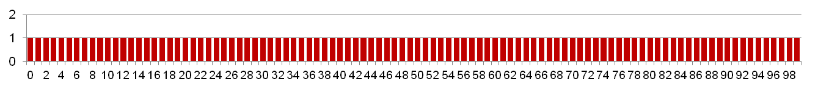
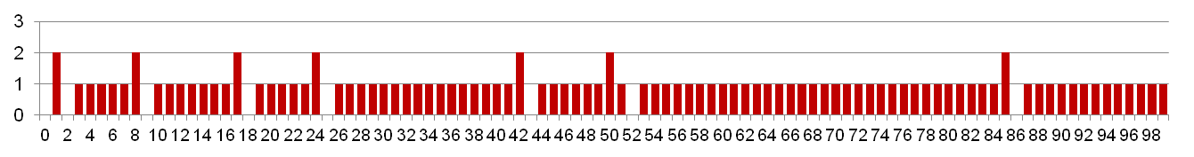
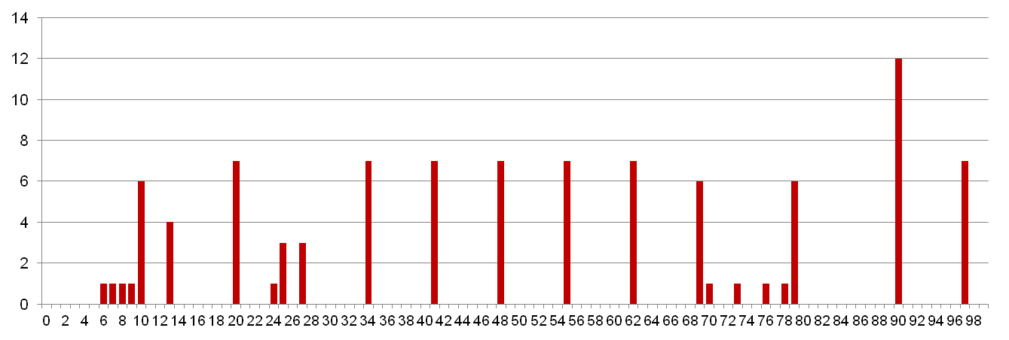
Experimental Results
No Race
Single core laptop
Multicore server
The race can really happen!

Slide 31
Race Elimination
/* Threaded program without the race */
int main()
{
pthread_t tid[N];
int i, *ptr;
for (i = 0; i < N; i++) {
ptr = Malloc(sizeof(int));
*ptr = i;
Pthread_create(&tid[i], NULL, thread, ptr);
}
for (i = 0; i < N; i++)
Pthread_join(tid[i], NULL);
exit(0);
}
/* Thread routine */
void *thread(void *vargp)
{
int myid = *((int *)vargp);
Free(vargp);
printf("Hello from thread %d\n", myid);
return NULL;
}
Avoid unintended sharing of state
norace.c

Slide 32
Another worry: Deadlock
Def: A process is deadlocked iff it is waiting for a condition that will never be true
Typical Scenario
  Processes 1 and 2 needs two resources (A and B) to proceed
  Process 1 acquires A, waits for B
  Process 2 acquires B, waits for A
  Both will wait forever!

Slide 33
Deadlocking With Semaphores
int main()
{
pthread_t tid[2];
Sem_init(&mutex[0], 0, 1); /* mutex[0] = 1 */
Sem_init(&mutex[1], 0, 1); /* mutex[1] = 1 */
Pthread_create(&tid[0], NULL, count, (void*) 0);
Pthread_create(&tid[1], NULL, count, (void*) 1);
Pthread_join(tid[0], NULL);
Pthread_join(tid[1], NULL);
printf("cnt=%d\n", cnt);
exit(0);
}
void *count(void *vargp)
{
int i;
int id = (int) vargp;
for (i = 0; i < NITERS; i++) {
P(&mutex[id]); P(&mutex[1-id]);
cnt++;
V(&mutex[id]); V(&mutex[1-id]);
}
return NULL;
}
Tid[0]:
P(s₀);
P(s₁);
cnt++;
V(s₀);
V(s₁);
Tid[1]:
P(s₁);
P(s₀);
cnt++;
V(s₁);
V(s₀);

Slide 34
Deadlock Visualized in Progress Graph
Thread 1
Locking introduces the
potential for deadlock:
waiting for a condition that will never be true
Any trajectory that enters
the deadlock region will
eventually reach the
deadlock state, waiting for either s₀ or s₁ to become nonzero
Other trajectories luck out and skirt the deadlock region
Unfortunate fact: deadlock is often nondeterministic (race)
V(s₀)
Deadlock
state
Forbidden region
for s₀
V(s₁)
P(s₀)
Forbidden region
for s₁
Deadlock
region
P(s₁)
Thread 0
P(s₀)
P(s₁)
V(s₀)
V(s₁)
s₀=s₁=1

Slide 35
Avoiding Deadlock
Acquire shared resources in same order
int main()
{
pthread_t tid[2];
Sem_init(&mutex[0], 0, 1); /* mutex[0] = 1 */
Sem_init(&mutex[1], 0, 1); /* mutex[1] = 1 */
Pthread_create(&tid[0], NULL, count, (void*) 0);
Pthread_create(&tid[1], NULL, count, (void*) 1);
Pthread_join(tid[0], NULL);
Pthread_join(tid[1], NULL);
printf("cnt=%d\n", cnt);
exit(0);
}
void *count(void *vargp)
{
int i;
int id = (int) vargp;
for (i = 0; i < NITERS; i++) {
P(&mutex[0]); P(&mutex[1]);
cnt++;
V(&mutex[id]); V(&mutex[1-id]);
}
return NULL;
}
Tid[0]:
P(s0);
P(s1);
cnt++;
V(s0);
V(s1);
Tid[1]:
P(s0);
P(s1);
cnt++;
V(s1);
V(s0);

Slide 36
Avoided Deadlock in Progress Graph
Thread 1
No way for trajectory to get stuck
Processes acquire locks in same order
Order in which locks released immaterial
V(s₀)
Forbidden region
for s₀
V(s₁)
P(s₁)
Forbidden region
for s₁
P(s₀)
Thread 0
P(s₀)
P(s₁)
V(s₀)
V(s₁)
s₀=s₁=1

Slide 37
Today
Parallel Computing Hardware
  Multicore
    Multiple separate processors on single chip
  Hyperthreading
    Efficient execution of multiple threads on single core
Thread-Level Parallelism
  Splitting program into independent tasks
    Example 1: Parallel summation
  Divide-and conquer parallelism
    Example 2: Parallel quicksort

Slide 38
Exploiting parallel execution
So far, we’ve used threads to deal with I/O delays
  e.g., one thread per client to prevent one from delaying another
Multi-core CPUs offer another opportunity
  Spread work over threads executing in parallel on N cores
  Happens automatically, if many independent tasks
    e.g., running many applications or serving many clients
  Can also write code to make one big task go faster
    by organizing it as multiple parallel sub-tasks
Our core i7 (Haswell) machines can execute 4 threads at once
  4 cores, with hyperthreading turned off.
  Theoretical speedup of 4x, never achieved in our benchmarks

Slide 39
Multicore Processor
Core 0
Core n-1
Regs
Regs
L1
d-cache
L1
i-cache
…
L1
d-cache
L1
i-cache
L2 unified cache
L2 unified cache
L3 unified cache
(shared by all cores)
Main memory
Intel Core i7 Haswell Processor
  Multiple processors operating with coherent view of memory

Slide 40
Example 1: Parallel Summation
Sum numbers 0, …, n-1
  Should add up to ((n-1)*n)/2
Partition values 1, …, n-1 into t ranges
  ⎣n/t⎦ values in each range
  Each of t threads processes 1 range
  For simplicity, assume n is a multiple of t
Let’s consider different ways that multiple threads might work on their assigned ranges in parallel

Slide 41
First attempt: psum-mutex
Simplest approach: Threads sum into a global variable protected by a semaphore mutex.
void *sum_mutex(void *vargp); /* Thread routine */
/* Global shared variables */
long gsum = 0; /* Global sum */
long nelems_per_thread; /* Number of elements to sum */
sem_t mutex; /* Mutex to protect global sum */
int main(int argc, char **argv)
{
long i, nelems, log_nelems, nthreads, myid[MAXTHREADS];
pthread_t tid[MAXTHREADS];
/* Get input arguments */
nthreads = atoi(argv[1]);
log_nelems = atoi(argv[2]);
nelems = (1L << log_nelems);
nelems_per_thread = nelems / nthreads;
sem_init(&mutex, 0, 1);
psum-mutex.c

Slide 42
psum-mutex (cont)
Simplest approach: Threads sum into a global variable protected by a semaphore mutex.
/* Create peer threads and wait for them to finish */
for (i = 0; i < nthreads; i++) {
myid[i] = i;
Pthread_create(&tid[i], NULL, sum_mutex, &myid[i]);
}
for (i = 0; i < nthreads; i++)
Pthread_join(tid[i], NULL);
/* Check final answer */
if (gsum != (nelems * (nelems-1))/2)
printf("Error: result=%ld\n", gsum);
exit(0);
}
psum-mutex.c

Slide 43
psum-mutex Thread Routine
Simplest approach: Threads sum into a global variable protected by a semaphore mutex.
/* Thread routine for psum-mutex.c */
void *sum_mutex(void *vargp)
{
long myid = *((long *)vargp); /* Extract thread ID */
long start = myid * nelems_per_thread; /* Start element index */
long end = start + nelems_per_thread; /* End element index */
long i;
for (i = start; i < end; i++) {
P(&mutex);
gsum += i;
V(&mutex);
}
return NULL;
}
psum-mutex.c

Slide 44
psum-mutex Performance
Core i7 (Haswell) system with 4 cores, n=2³¹
Threads (Cores) | 1 (1) | 2 (2) | 4 (4) | 8 (4) | 16 (4)
psum-mutex (secs) | 68 | 432 | 719 | 552 | 599
Nasty surprise:
  Single thread is very slow
  Gets slower as we use more cores

Slide 45
Next Attempt: psum-array
Peer thread i sums into global array element psum[i]
Main waits for theads to finish, then sums elements of psum
Eliminates need for mutex synchronization
/* Thread routine for psum-array.c */
void *sum_array(void *vargp)
{
long myid = *((long *)vargp); /* Extract thread ID */
long start = myid * nelems_per_thread; /* Start element index */
long end = start + nelems_per_thread; /* End element index */
long i;
for (i = start; i < end; i++) {
psum[myid] += i;
}
return NULL;
}
psum-array.c

Slide 46
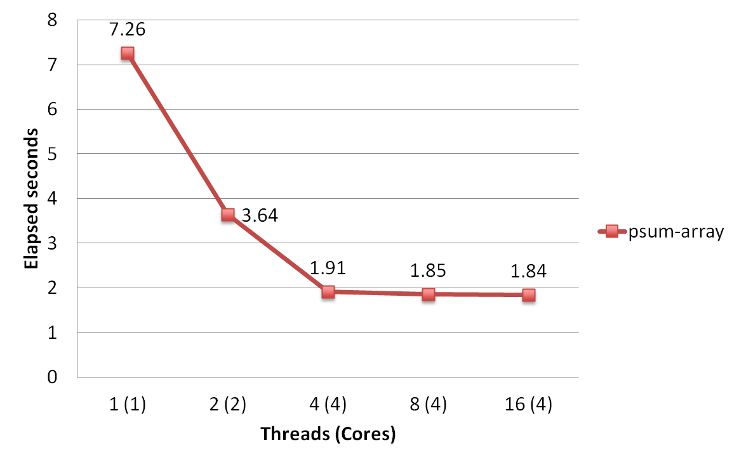
psum-array Performance
Orders of magnitude faster than psum-mutex

Slide 47
Next Attempt: psum-local
Reduce memory references by having peer thread i sum into a local variable (register)
/* Thread routine for psum-local.c */
void *sum_local(void *vargp)
{
long myid = *((long *)vargp); /* Extract thread ID */
long start = myid * nelems_per_thread; /* Start element index */
long end = start + nelems_per_thread; /* End element index */
long i, sum = 0;
for (i = start; i < end; i++) {
sum += i;
}
psum[myid] = sum;
return NULL;
}
psum-local.c

Slide 48
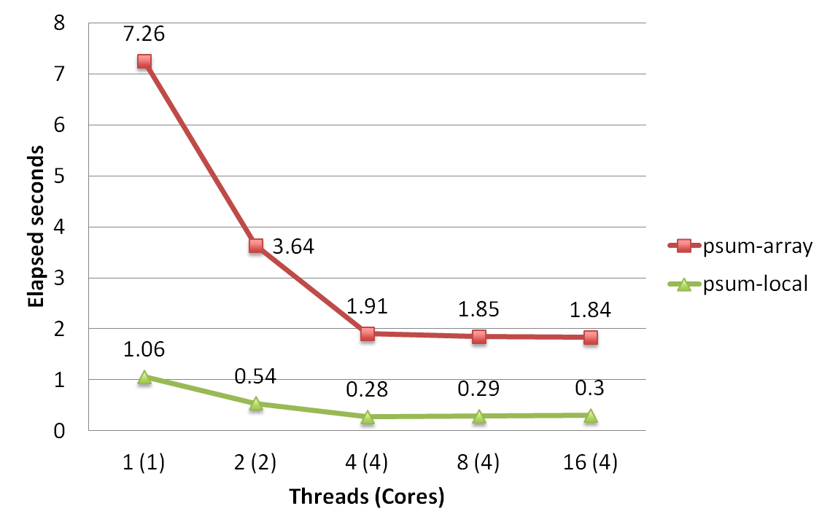
psum-local Performance
Almost an order of magnitude faster than psum-array

Slide 49
Characterizing Parallel Program Performance
p processor cores, T_{k} is the running time using k cores
Def. Speedup: S_{p} = T₁ / T_{p}
  S_{p} is relative speedup if T₁ is running time of parallel version of the code running on 1 core.
  S_{p} is absolute speedup if T₁ is running time of sequential version of code running on 1 core.
  Absolute speedup is a much truer measure of the benefits of parallelism.
Def. Efficiency: E_{p} = S_{p} /p = T₁ /(pT_{p})
  Reported as a percentage in the range (0, 100].
  Measures the overhead due to parallelization

Slide 50
Performance of psum-local
Threads (t) | 1 | 2 | 4 | 8 | 16
Cores (p) | 1 | 2 | 4 | 4 | 4
Running time (T_{p}) | 1.06 | 0.54 | 0.28 | 0.39 | 0.30
Speedup (S_{p}) | 1 | 1.9 | 3.8 | 3.7 | 3.5
Efficiency (E_{p}) | 100% | 98% | 95% | 91% | 88%
Efficiencies > 90% are very good
But only because our example is easily parallelizable
Real codes are often much harder to parallelize
  e.g., parallel quicksort later in this lecture

Slide 51
Amdahl’s Law
Captures the difficulty of using parallelism to speed things up.
Overall problem
  T Total sequential time required
  p Fraction of total that can be sped up (0 ≤ p ≤ 1)
  k Speedup factor
Resulting Performance
  T_{k} = pT/k + (1-p)T
    Portion which can be sped up runs k times faster
    Portion which cannot be sped up stays the same
  Least possible running time:
    k = ∞
    T∞ = (1-p)T

Slide 52
Amdahl’s Law Example
Overall problem
  T = 10 Total time required
  p = 0.9 Fraction of total which can be sped up
  k = 9 Speedup factor
Resulting Performance
  T₉ = 0.9 * 10/9 + 0.1 * 10 = 1.0 + 1.0 = 2.0
  Least possible running time:
    T∞ = 0.1 * 10.0 = 1.0

Slide 53
A More Substantial Example: Sort
Sort set of N random numbers
Multiple possible algorithms
  Use parallel version of quicksort
Sequential quicksort of set of values X
  Choose “pivot” p from X
  Rearrange X into
    L: Values ≤ p
    R: Values ≥ p
  Recursively sort L to get L′
  Recursively sort R to get R′
  Return L′ : p : R′

Slide 54
Sequential Quicksort Visualized
X
p
L
p
R
p2
L2
p2
R2
•
•
•
L′

Slide 55
Sequential Quicksort Visualized
X
L′
p
R
p3
L3
p3
R3
•
•
•
R′
L′
p
R′

Slide 56
Sequential Quicksort Code
void qsort_serial(data_t *base, size_t nele) {
if (nele <= 1)
return;
if (nele == 2) {
if (base[0] > base[1])
swap(base, base+1);
return;
}
/* Partition returns index of pivot */
size_t m = partition(base, nele);
if (m > 1)
qsort_serial(base, m);
if (nele-1 > m+1)
qsort_serial(base+m+1, nele-m-1);
}
Sort nele elements starting at base
  Recursively sort L or R if has more than one element

Slide 57
Parallel Quicksort
Parallel quicksort of set of values X
  If N ≤ Nthresh, do sequential quicksort
  Else
    Choose “pivot” p from X
    Rearrange X into
      L: Values ≤ p
      R: Values ≥ p
    Recursively spawn separate threads
      Sort L to get L′
      Sort R to get R′
    Return L′ : p : R′

Slide 58
Parallel Quicksort Visualized
X
p
L
p
R
p2
p3
L2
p2
R2
p
L3
p3
R3
•
•
•
•
•
•
L′
p
R′

Slide 59
Thread Structure: Sorting Tasks
X
• • •
Task Threads
Task: Sort subrange of data
  Specify as:
    base: Starting address
    nele: Number of elements in subrange
Run as separate thread

Slide 60
Small Sort Task Operation
X
• • •
Task Threads
Sort subrange using serial quicksort

Slide 61
Large Sort Task Operation
X
L
p
R
Partition Subrange
• • •
X
L
p
R
Spawn 2 tasks
• • •

Slide 62
Top-Level Function (Simplified)
void tqsort(data_t *base, size_t nele) {
init_task(nele);
global_base = base;
global_end = global_base + nele - 1;
task_queue_ptr tq = new_task_queue();
tqsort_helper(base, nele, tq);
join_tasks(tq);
free_task_queue(tq);
}
Sets up data structures
Calls recursive sort routine
Keeps joining threads until none left
Frees data structures

Slide 63
Recursive sort routine (Simplified)
/* Multi-threaded quicksort */
static void tqsort_helper(data_t *base, size_t nele,
task_queue_ptr tq) {
if (nele <= nele_max_sort_serial) {
/* Use sequential sort */
qsort_serial(base, nele);
}
sort_task_t *t = new_task(base, nele, tq);
spawn_task(tq, sort_thread, (void *) t);
}
Small partition: Sort serially
Large partition: Spawn new sort task

Slide 64
Sort task thread (Simplified)
/* Thread routine for many-threaded quicksort */
static void *sort_thread(void *vargp) {
sort_task_t *t = (sort_task_t *) vargp;
data_t *base = t->base;
size_t nele = t->nele;
task_queue_ptr tq = t->tq;
free(vargp);
size_t m = partition(base, nele);
if (m > 1)
tqsort_helper(base, m, tq);
if (nele-1 > m+1)
tqsort_helper(base+m+1, nele-m-1, tq);
return NULL;
}
Get task parameters
Perform partitioning step
Call recursive sort routine on each partition

Slide 65
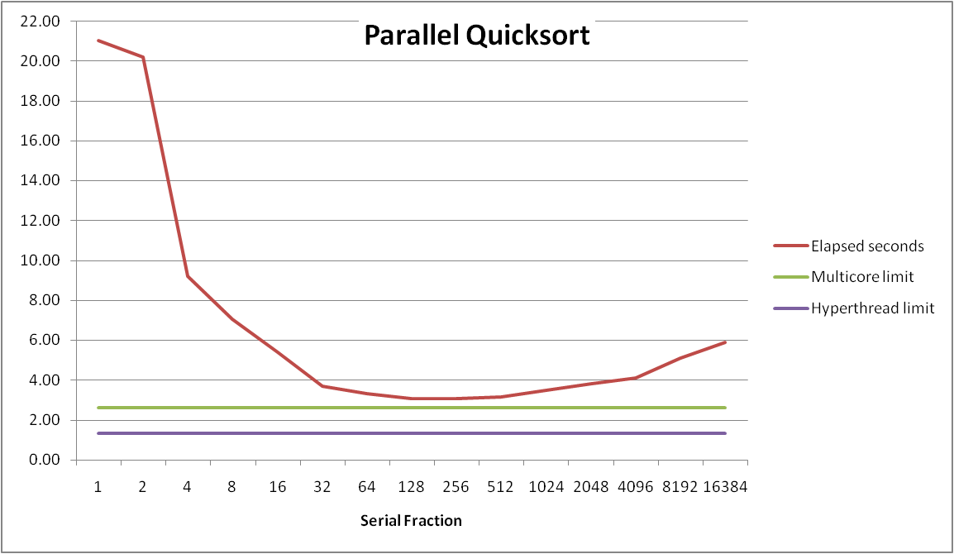
Parallel Quicksort Performance
Serial fraction: Fraction of input at which do serial sort
Sort 2³⁷ (134,217,728) random values
Best speedup = 6.84X

Slide 66
Parallel Quicksort Performance
Good performance over wide range of fraction values
  F too small: Not enough parallelism
  F too large: Thread overhead + run out of thread memory

Slide 67
Amdahl’s Law & Parallel Quicksort
Sequential bottleneck
  Top-level partition: No speedup
  Second level: ≤ 2X speedup
  k^{th} level: ≤ 2^{k-1}X speedup
Implications
  Good performance for small-scale parallelism
  Would need to parallelize partitioning step to get large-scale parallelism
    Parallel Sorting by Regular Sampling
      H. Shi & J. Schaeffer, J. Parallel & Distributed Computing, 1992

Slide 68
Lessons Learned
Must have parallelization strategy
  Partition into K independent parts
  Divide-and-conquer
Inner loops must be synchronization free
  Synchronization operations very expensive
Beware of Amdahl’s Law
  Serial code can become bottleneck
You can do it!
  Achieving modest levels of parallelism is not difficult
  Set up experimental framework and test multiple strategies

Slide 69
Memory Consistency
int a = 1;
int b = 100;
Thread consistency
constraints
Wa
Rb
Thread1:
Wa: a = 2;
Rb: print(b);
Thread2:
Wb: b = 200;
Ra: print(a);
Wb
Ra
What are the possible values printed?
  Depends on memory consistency model
  Abstract model of how hardware handles concurrent accesses
Sequential consistency
  Overall effect consistent with each individual thread
  Otherwise, arbitrary interleaving

Slide 70
Sequential Consistency Example
Thread consistency
constraints
int a = 1;
int b = 100;
Wa
Rb
Thread1:
Wa: a = 2;
Rb: print(b);
Thread2:
Wb: b = 200;
Ra: print(a);
Wb
Ra
Rb
Wb
Ra
100, 2
Wa
Rb
Ra
200, 2
Wb
Ra
Rb
2, 200
Ra
Wa
Rb
1, 200
Wb
Ra
Rb
2, 200
Wa
Rb
Ra
200, 2
Impossible outputs
  100, 1 and 1, 100
  Would require reaching both Ra and Rb before Wa and Wb

Slide 71
Non-Coherent Cache Scenario
int a = 1;
int b = 100;
Write-back caches, without coordination between them
Thread1:
Wa: a = 2;
Rb: print(b);
Thread2:
Wb: b = 200;
Ra: print(a);
Thread1 Cache
Thread2 Cache
a: 2
b:100
a:1
b:200
print 1
print 100
Main Memory
a:1
b:100

Slide 72
Snoopy Caches
int a = 1;
int b = 100;
Tag each cache block with state
  Invalid Cannot use value
  Shared Readable copy
  Exclusive Writeable copy
Thread1:
Wa: a = 2;
Rb: print(b);
Thread2:
Wb: b = 200;
Ra: print(a);
Thread1 Cache
Thread2 Cache
E
a: 2
E
b:200
Main Memory
a:1
b:100

Slide 73
Snoopy Caches
int a = 1;
int b = 100;
Tag each cache block with state
  Invalid Cannot use value
  Shared Readable copy
  Exclusive Writeable copy
Thread1:
Wa: a = 2;
Rb: print(b);
Thread2:
Wb: b = 200;
Ra: print(a);
Thread1 Cache
Thread2 Cache
E
S
a: 2
a: 2
S
a:2
print 2
S
b:200
S
b:200
E
b:200
print 200
Main Memory
When cache sees request for one of its E-tagged blocks
  Supply value from cache
  Set tag to S
a:1
b:100

Slide 74
Hyperthreading: Out-of-Order Processor Structure
Instruction Control
Instruction
Cache
Instruction Decoder
Registers
Op. Queue
PC
Functional Units
Data Cache
Integer
Arith
Integer
Arith
FP
Arith
Load /
Store
Instruction control dynamically converts program into stream of operations
Operations mapped onto functional units to execute in parallel

Slide 75
Hyperthreading Implementation
Instruction Control
Instruction
Cache
Instruction Decoder
Reg A
Op. Queue A
Reg B
Op. Queue B
PC A
PC B
Functional Units
Data Cache
Integer
Arith
Integer
Arith
FP
Arith
Load /
Store
Replicate enough instruction control to process K instruction streams
K copies of all registers
Share functional units

Slide 76
Parallelizing Partitioning Step
X₁
X₂
X₃
X₄
p
Parallel partitioning based on global p
L₁
R₁
L₂
R₂
L₃
R₃
L₄
R₄
Reassemble into partitions
L₁
L₂
L₃
L₄
R₁
R₂
R₃
R₄

Slide 77
Experience with Parallel Partitioning
Could not obtain speedup
Speculate: Too much data copying
  Could not do everything within source array
  Set up temporary space for reassembling partition

